Slide 1

ENIAC Brazil Expansion
Exploring new horizons

Slide 2


ENIAC
Exploring possible expansion into the Brazilian Market with Magist
Are Brazilian customers aligned with our target demographic?
Can Magist deliver our products as quickly as our customers expect?
Does our potential market in Brazil have a preference for Apple-centric products?

Slide 3
ENIAC - Magist Low Value Product Partnership
ENIAC
Average Price(Magist)
Average Price (ENIAC)
Customer Satisfaction(Magist)
153€
540€
4.0
Partner on low value products.

Slide 4
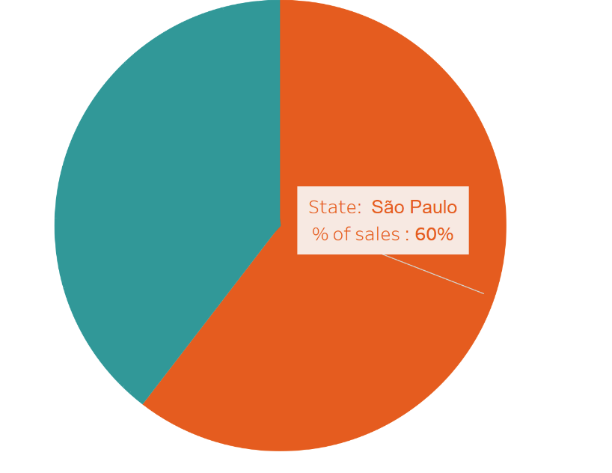
Largest market share - São Paulo
ENIAC

Slide 5
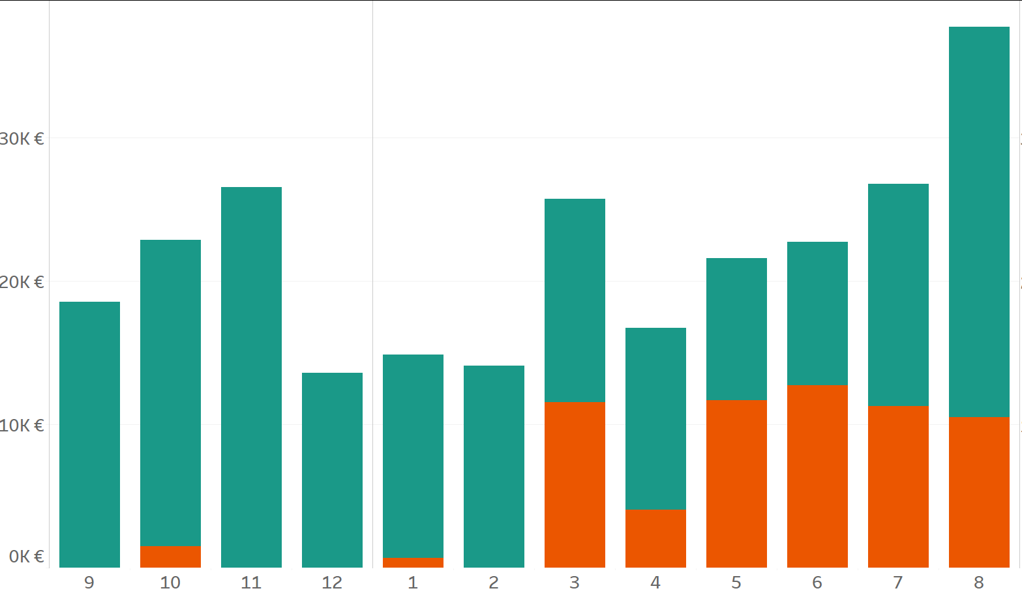
Prospective growth chance
ENIAC
Small, but growing telephony market
Quickly expanding premium segment

Slide 6
ENIAC
Sellers on the premium phone market
Sales of Telephony devices in Brazil from 2017/9-2018/9
41
Premium Vendors
Vendors of 500$+ devices in the last year
616
Vendors on the whole telephony market

Slide 7
ENIAC
Delivery Rate Efficiency
8.6%
Products delivered within 3 days of order placement in the last year but jumped to 37% delivered within 7 days
87.3%
Products delivered within 3 days were in São Paulo

Slide 8
Recommendation
São Paulo
Rio de Janeiro
Paraná
ENIAC
Trial Market
Assessment of Magist contract renewal
2020
2019
Q4’20
Proposed expansion

Slide 9

Thank you

